Slide 1
Cinematrix
Movie Recommender App
By:
Dexter Cruz Pablo Maceda Michael Kung Kerry Kovacik Kristen Cannon
2019
Data Analysis and Visualization Bootcamp at Texas McCombs
1

Slide 2
Overview
Goal:
Implement various Machine Learning algorithms to determine the best Recommender System technique(s) to create a Movie Recommender App.
Data:
Data for this project was collected by GroupLens Research and made available from the MovieLens website.
2019
Data Analysis and Visualization Bootcamp at Texas McCombs
2

Slide 3
Table of Contents
Title Page
Project Overview
TOC
About the Data
Infrastructure
6. Random Forest: Label Encoder
7. Random Forest: One Hot Encoding
7. Matrix-Factorization:
- Deep Learning
2019
Data Analysis and Visualization Bootcamp at Texas McCombs
3

Slide 4
About the Data
Click each shape below to explore detailed data information
100,000
Ratings
(1-5)
1,682
Movies
943
Users
User
Info
2019
Data Analysis and Visualization Bootcamp at Texas McCombs
4

Slide 5
Movie Recommender Architecture
Project Concept
Data Collection
Preprocessing/Cleaning Data
Data Exploration
Modeling
Modeling
Modeling
Evaluating Results
2019
Data Analysis and Visualization Bootcamp at Texas McCombs
5

Slide 6
Random Forest
As expected, Random Forest was an inaccurate predicter of movie rating regardless of features used.
Label Encoder vs One Hot Encoding
35.372%
accuracy
33.688%
accuracy
2019
Data Analysis and Visualization Bootcamp at Texas McCombs
6

Slide 7
Random Forest
As expected, Random Forest was an inaccurate predicter of movie rating regardless of features used.
Model 1: Label Encoder
Features:
User Id
Item Id
Age
Occupation
Gender
Genres
33.688%
accuracy
2019
Data Analysis and Visualization Bootcamp at Texas McCombs
7

Slide 8
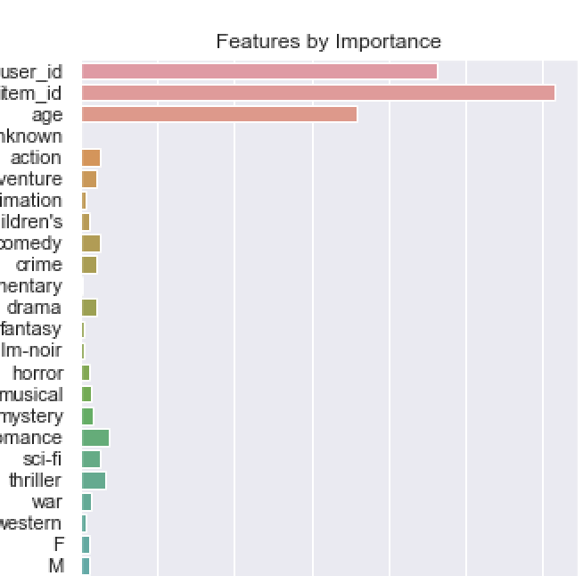
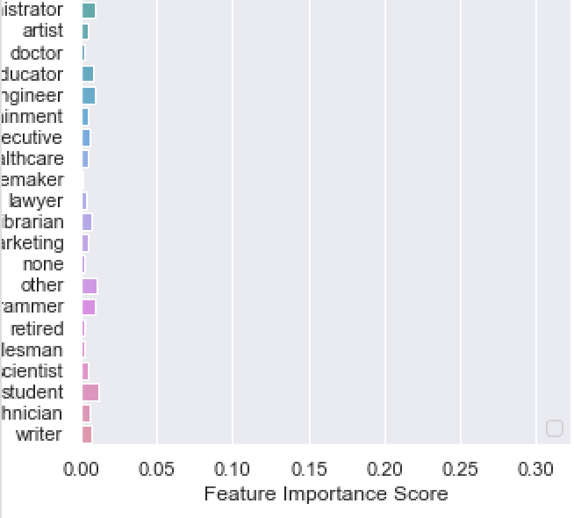
Random Forest
As expected, Random Forest was an inaccurate predicter of movie rating regardless of features used.
Model 2: One Hot Encoding
Features:
user_id
item_id
age
occupation
gender
genres
35.372%
accuracy
2019
Data Analysis and Visualization Bootcamp at Texas McCombs
8

Slide 9
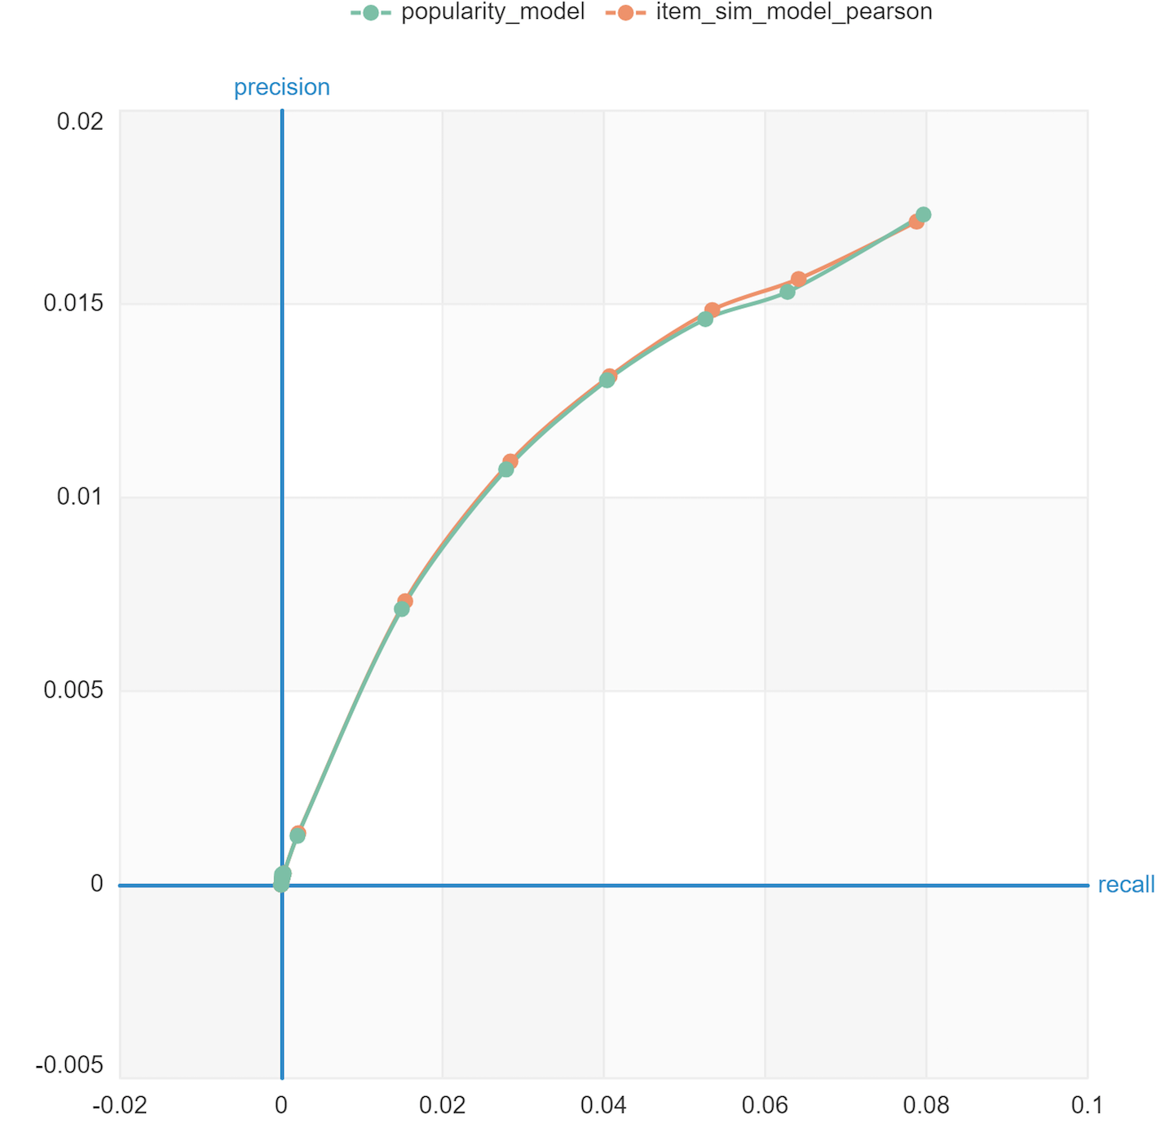
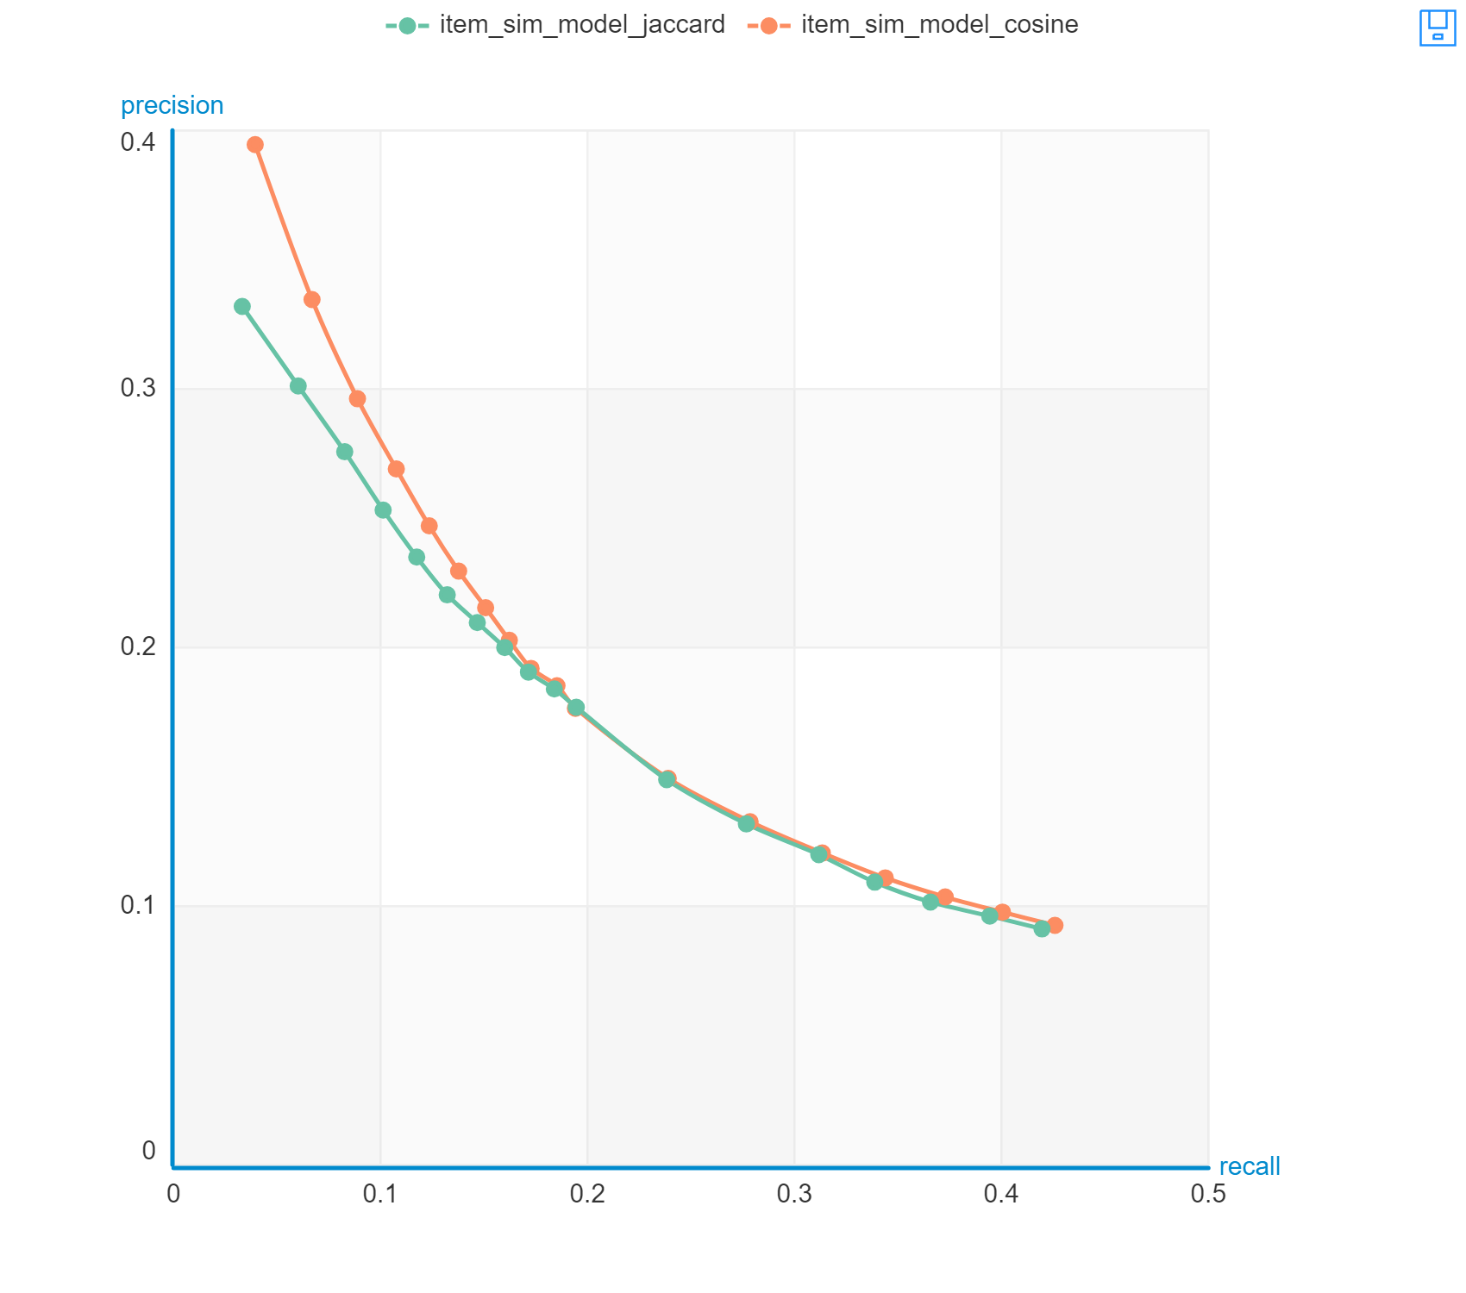
Popularity Based Model vs Pearson Correlation
Jaccard Similarity
vs Cosine Similarity
2019
Data Analysis and Visualization Bootcamp at Texas McCombs
9

Slide 10
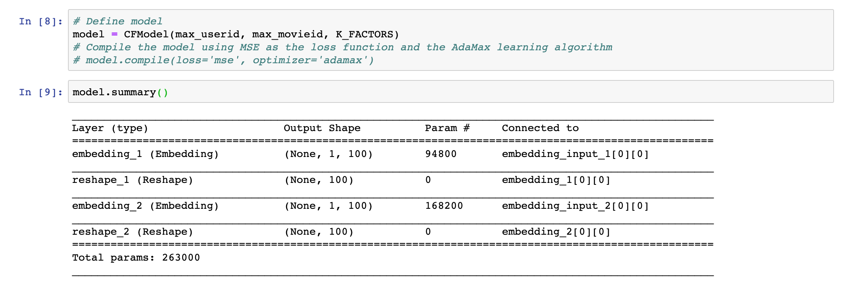
Collaborative Filtering vs Deep Learning
Matrix-Factorization
2019
Data Analysis and Visualization Bootcamp at Texas McCombs
10

Slide 11
Root Mean Square Error (RMSE)
Model Name | Root Mean Squared Error (RMSE)
1998 Random Forest | 1.5878
2018 Fandom Forest | 1.7371
1998 Turicreate Popularity | 1.0278
1998 Turicreate Factorization | 0.9693
2018 Deep Learning | 1.0686
2019
Data Analysis and Visualization Bootcamp at Texas McCombs
11

